Slide 1

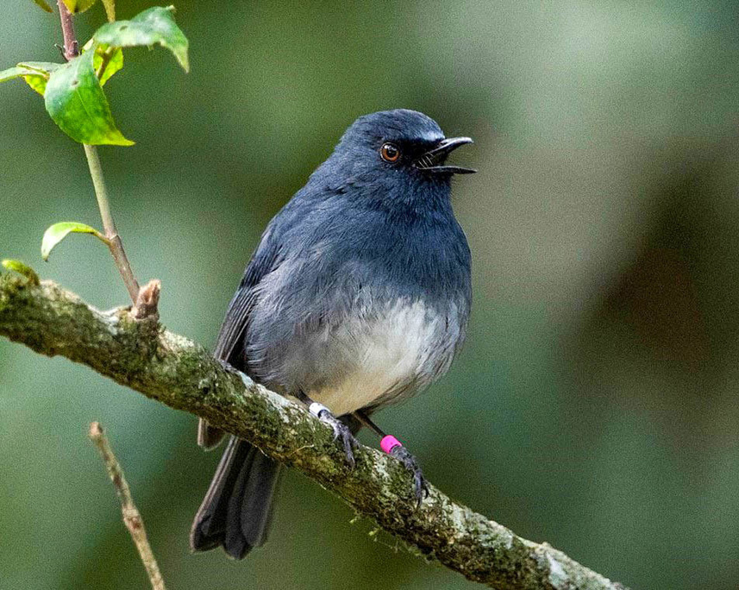
Bird Audio Classification
Deep Learning Project

Slide 2
Project Pipeline
Raw Audio
Cleaning
Splitting
Preprocessing
Mel-Spectrograms
Augmentation
Train the Models
Models Evaluation

Slide 3
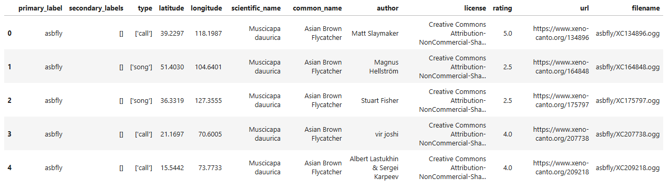
Dataset Structure
  Metadata file: train_metadata.csv
  Important fields: primary_label, filename, author
  Shape: (24459, 12)

Slide 4
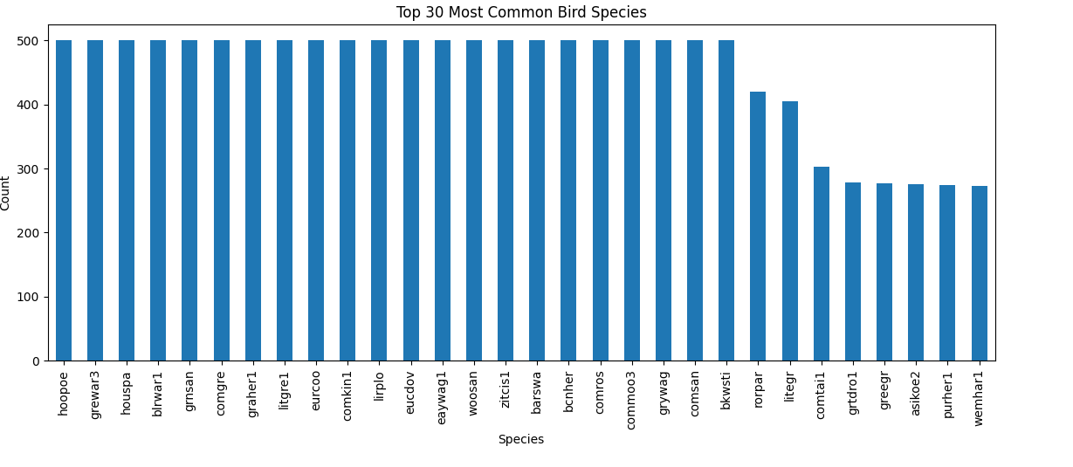
Species Distribution
  Species frequencies vary significantly
  Some species have thousands of recordings, others have very few
  We select Top-10 to enhance the robustness of our training process.

Slide 5
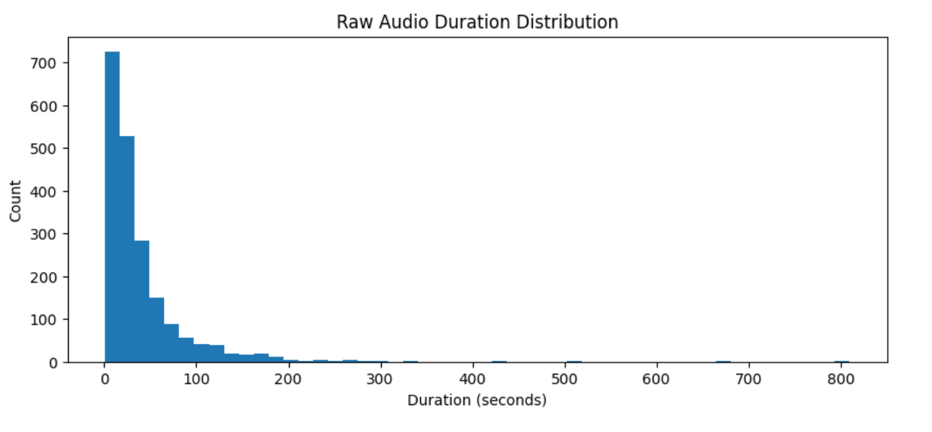
Raw Audio Duration Distribution
  Audio clips vary greatly in length
  Many recordings are short, others exceed 60 seconds
  Neural networks require fixed-length inputs
  Preprocessing step normalizes all clips to 5 seconds

Slide 6
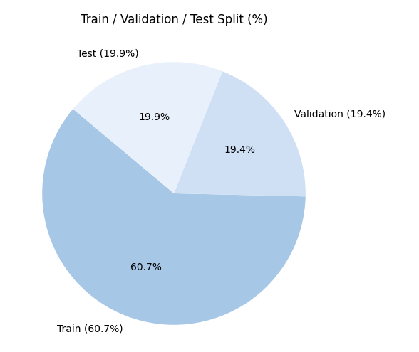
Grouped Dataset Split
  Splitting based on author to prevent data leakage
  Proportions:
  Train: 60%
  Validation: 20%
  Test: 20%
  Ensures that different sets contain audio from different recorders

Slide 7

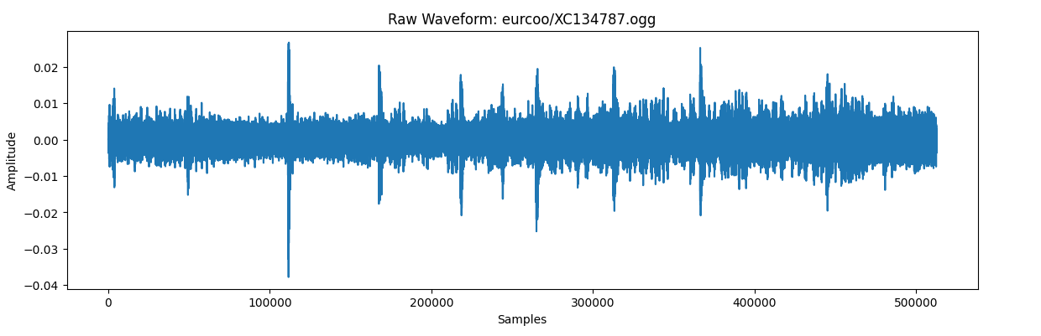
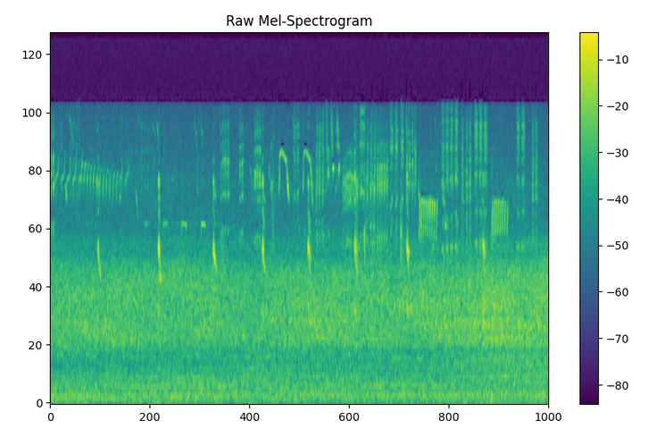
Visualizing Raw Waveform and Spectrogram
Waveform shows amplitude over time
Mel-Spectrogram shows frequency content

Slide 8
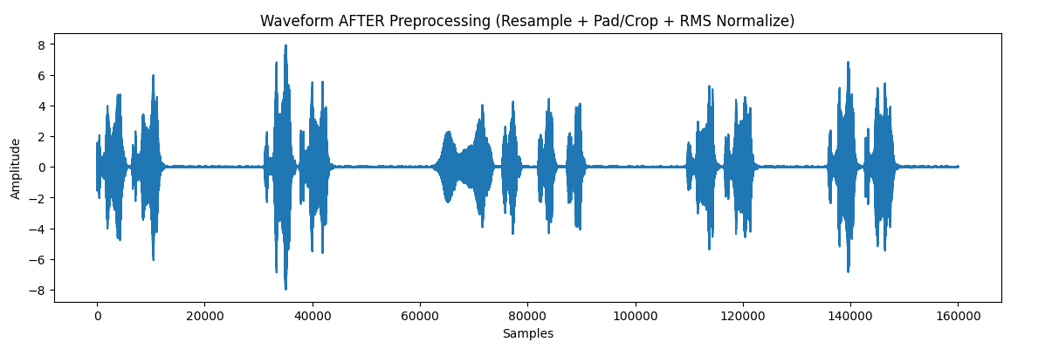
Preparing Audio for Feature Extraction
(Resampling, Padding, Cropping)
Steps applied to every audio file:
  Convert to mono
  Resample to 32,000 Hz
  Fix length to 5 seconds
  Apply RMS normalization

Slide 9
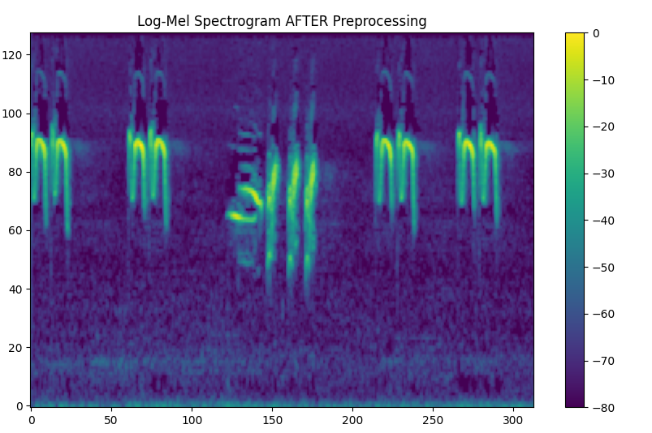
Log-Mel Spectrogram Extraction
  Window size (FFT): 2048
  Hop length: 512
  Mel filters: 128
  Log-Mel spectrograms used as inputs to the model
  They compress audio while preserving important patterns

Slide 10
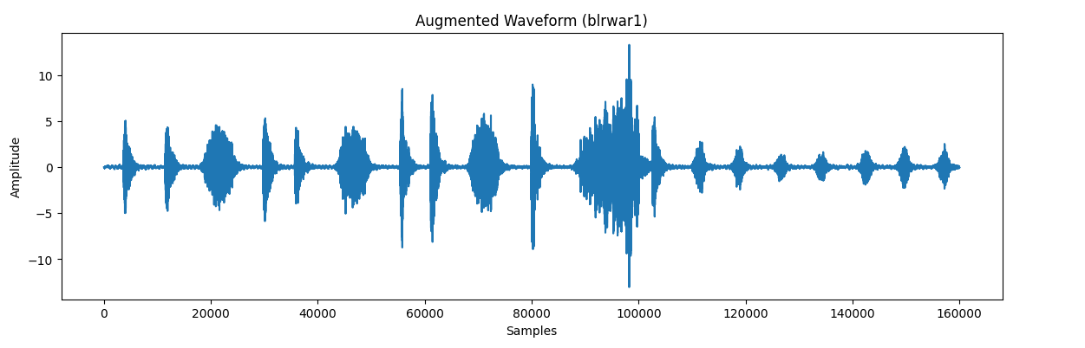
Data Augmentation for Training
To expand the dataset and reduce overfitting:
  Pitch shifting: ±2 semitones
  Time stretching: 0.85x–1.15x
  Gaussian noise: std = 0.005
  Augmentation improves model robustness

Slide 11
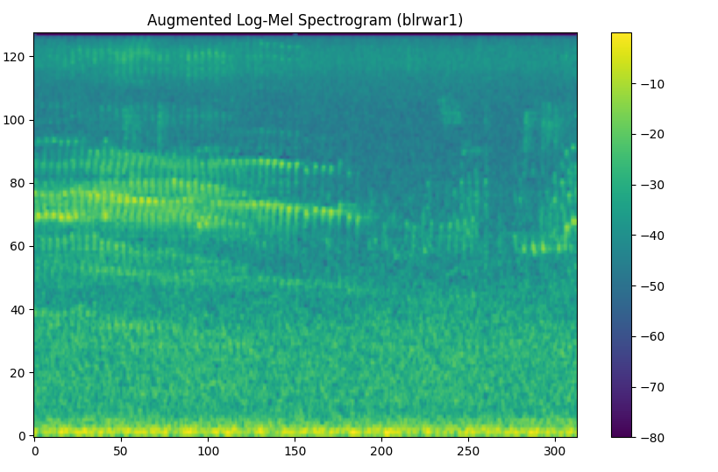
Augmented Mel-Spectrograms
  Spectrograms change shape depending on augmentation
  Pitch shift → vertical shift
  Time stretch → horizontal stretch
  Noise → texture changes

Slide 12
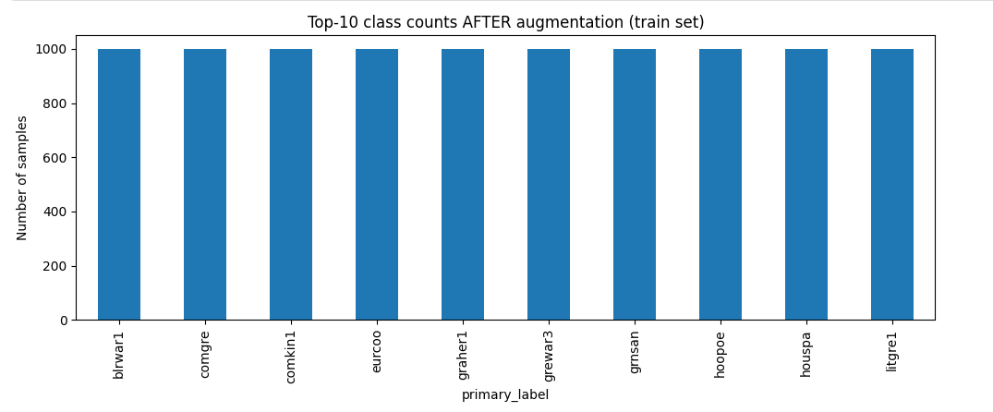
Class Balancing using Augmentation
  Target: 1000 samples per class
  Augmentation applied only to training set
  Final dataset becomes balanced → prevents model bias

Slide 13
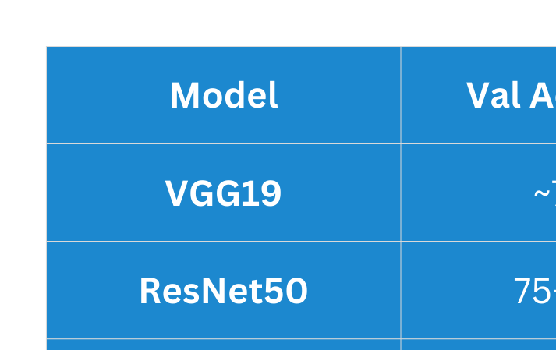
Models Performance Summary

Slide 14
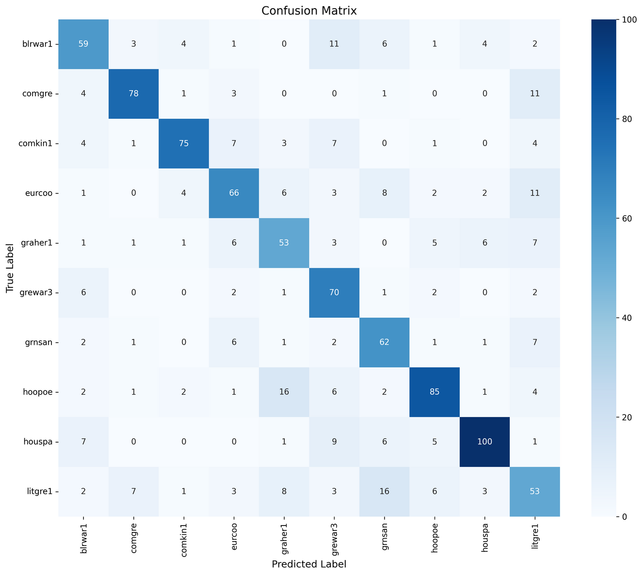
Results & Plots
VGG19
The model shows strong correct classification on most classes, especially houspa and hoopoe, with some confusion between similar bird species like graher1 and litgre1.

Slide 15
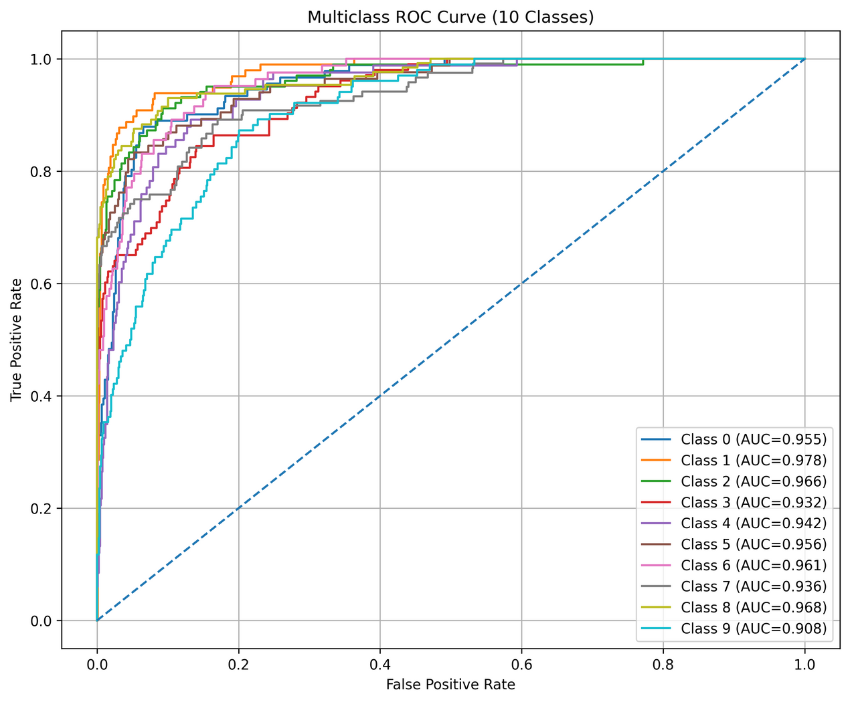
Results & Plots
VGG19
All classes achieved high AUC values (0.90–0.98), which indicates excellent class separability and strong overall discrimination performance.

Slide 16
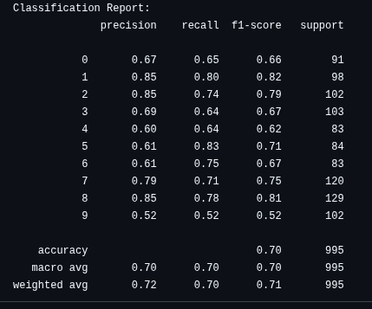
Results & Plots
VGG19
The model achieved 70% overall accuracy with a balanced weighted F1-score of 0.71, showing good general performance with slight weakness in Class 9.

Slide 17
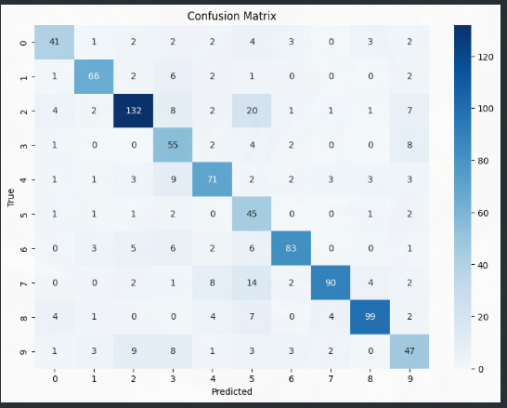
Results & Plots
ResNet50
The model shows strong correct predictions across most classes, especially classes 2, 7, and 8, with minor confusion between a few similar categories.

Slide 18
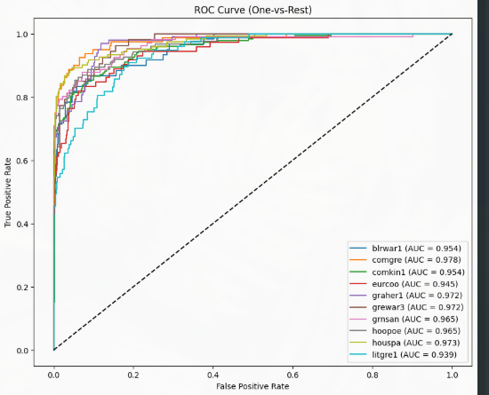
Results & Plots
ResNet50
All classes achieved high AUC values (≈0.94–0.98), indicating excellent discrimination ability and strong class separation.

Slide 19
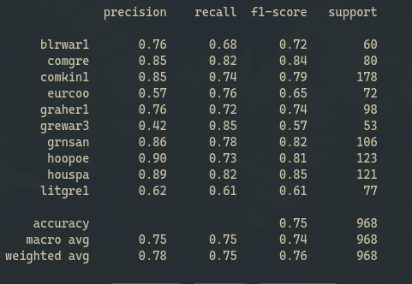
Results & Plots
ResNet50
The model achieved 75% overall accuracy with a weighted F1-score of 0.76, showing stable and reliable overall performance.
Classification Report

Slide 20
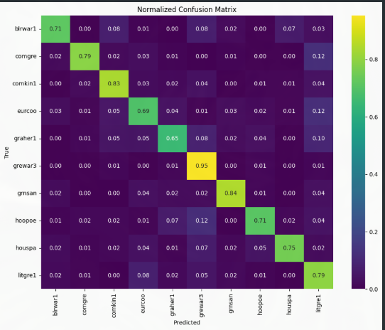
Results & Plots
Inception-V1
The model shows strong class-wise performance, especially for grewar3, grnsan, and litgre1, with limited confusion among most classes.

Slide 21
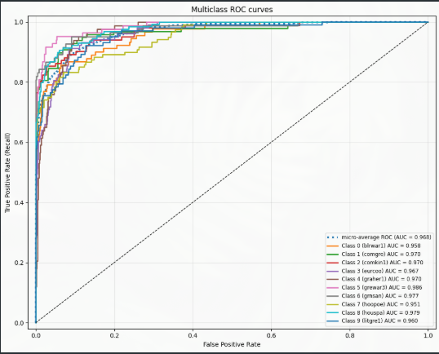
Results & Plots
Inception-V1
The model achieved excellent ROC performance with micro-average AUC ≈ 0.97, confirming strong overall class separability.

Slide 22
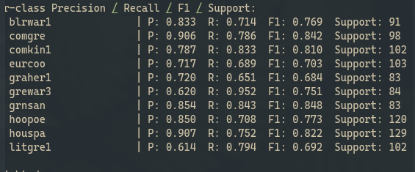
Results & Plots
Inception-V1
The model achieved 77% overall accuracy with a weighted F1-score of 0.77, showing balanced performance across most classes, with strongest results on comgre, grnsan, and houspa.

Slide 23
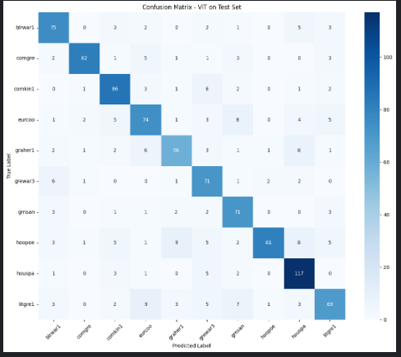
Results & Plots
ViT-B/16
The model shows high correct classification on most classes, especially houspa, hoopoe, and comgre, with limited confusion between similar bird species.

Slide 24
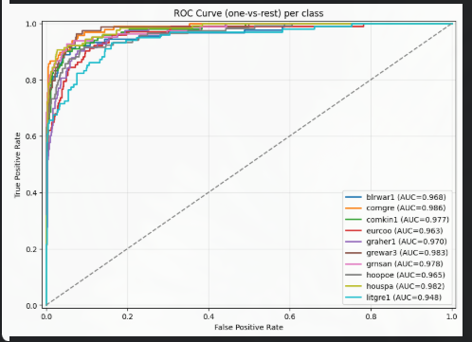
Results & Plots
ViT-B/16
All classes achieved excellent AUC values (≈0.95–0.99), confirming very strong class separability and discrimination performance.

Slide 25
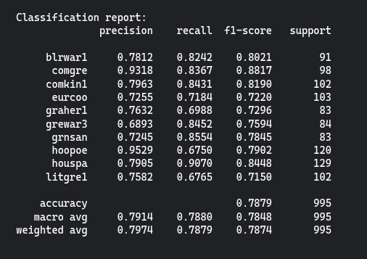
Results & Plots
ViT-B/16
The model achieved 78.8% overall accuracy with a weighted F1-score of 0.79, showing strong and balanced performance across most classes.

Slide 26
VGG19
RESNET50
Strengths:
  Simple, stable architecture
  Good at local texture detection
Weaknesses:
  No residual connections → vanishing gradients
  Very large model → slow & heavy
  Weak generalization on spectrograms
  Overfits easily
Why performance is lowest:
  Cannot capture long-range time–frequency relationships
  Struggles with complex bird call patterns
Test Accuracy: ~70%
Strengths:
  Residual blocks solve vanishing gradients
  Learns hierarchical spectrogram features
  Good generalization and stable training
  Performs strongly even with partial fine-tuning
Weaknesses:
  Heavier than Inception
  Not as global as Transformers
Why it performs well:
  Skip connections help learn harmonic structures and frequency patterns
  Fine-tuning layer3 + classifier prevents overfitting
Test Accuracy: ~77.2%

Slide 27
INCEPTION-V1
VIT
Strengths:
  Multi-scale convolution filters
  Efficient and lightweight
  Good for varying bird frequencies
Weaknesses:
  No residuals (weaker than modern CNNs)
  Optimization less stable than ResNet
  Harder to fine-tune
Why performance is close to ResNet:
  Multi-scale kernels detect patterns at different spectral resolutions
Test Accuracy: ~76.9%
Strengths:
  Captures long-range time–frequency dependencies
  Learns global spectrogram structure
  Benefits from SpecAugment & balanced dataset
  Best representation learning
Weaknesses:
  Requires more data
  Sensitive to hyperparameters
  Heavier compute cost
Why it performs best:
  Attention mechanism models harmonic trajectories, modulations, and repeated bird calls
  Works extremely well with mel-spectrograms due to global receptive field
Test Accuracy: ~78.8% (Best)

Slide 28
References
  VGG: https://arxiv.org/pdf/1409.1556
  ResNet: https://arxiv.org/abs/1512.03385
  V1:https://github.com/NohaAteff/Transfer_Learning/blob/main/Googlenet.ipynb
  ViT: @34123699765488 https://arxiv.org/abs/2306.06050

Slide 29
Thank You!
Q?

